Slide 1
End-to-end ML
Varol Kayhan, PhD

Slide 2
End-to-End ML (and our Agenda)
Problem definition
Get the data
Discover and visualize the data
Data preparation
Select a model and train
Fine tuning
Present solution
Launch, monitor, maintain
Evaluate the model

Slide 3
Problem Definition
Select SPECIFIC goals/problems!
Avoid broad problems!
Several questions to ask:
What is the expected benefit?
Is it supervised or unsupervised?
Is it regression or classification (binary or multi-class)?

Slide 4
Get the Data
What is the unit of analysis?
What are the predictors (features)?
What is the target/outcome variable?
Where is the data coming from?
Internal, external, combined?
How much data do you have (i.e., how many rows?)
What do to if data is too little or too much?

Slide 5
Discover and Visualize
Use visualization.
Histograms, boxplots, scatter plots
Use multiple variables in one plot when possible
Observe descriptive statistics.
How to interpret mean, median, std.dev, min, max?
Observe correlations
What is correlation?
Reduce variables (if needed) (how?)

Slide 6
Data Preparation
Perform "feature engineering" (if needed)
Derive variables using other variables
Convert continuous to categorical
Create new categories from existing categories
Etc.
Transform skewed variables if needed.

Slide 7
Data Preparation
Convert categorical text to numerical values:
"Ordinal encoding“ OR "one-hot-encoding"
Size | Color | Price
Compact | White | 22,000
Compact | Red | 22,750
Mid-size | Black | 25,000
Full-size | White | 32,000
Mid-size | Red | 26,000
Size | White | Red | Black | Price
1 | 1 | 0 | 0 | 22,000
1 | 0 | 1 | 0 | 22,750
2 | 0 | 0 | 1 | 25,000
3 | 1 | 0 | 0 | 32,000
2 | 0 | 1 | 0 | 26,000
Ordinal encoding
One-hot-encoding

Slide 8

Data Preparation
Standardize continuous variables (why???)
Standardized value$=\frac{x−x_{mean}}{x_{std.dev.}}$
Age | Salary | Default
23 | 58,560 | 1
21 | 78,224 | 1
25 | 86,571 | 0
20 | 78,841 | 1
24 | 63,839 | 0
Age_std | Salary_std | Default
0.19 | -1.26 | 1
-0.77 | 0.43 | 1
1.16 | 1.15 | 0
-1.25 | 0.49 | 1
0.68 | -0.81 | 0
Mean = 22.6
Std.Dev. = 2.07
Mean = 73,207
Std.Dev. = 11,595

Slide 9
Data Preparation
Identify and deal with missing values
Drop those rows/colums?
Impute values (mean/median/etc.)?
Age | Salary | Default
 | 58,560 | 1
 | 78,224 | 1
25 |  | 0
20 |  | 1
24 | 63,839 | 0
Age | Salary | Default
23 | 58,560 | 1
21 | 78,224 | 1
25 | 86,571 | 0
20 |  | 1
24 | 63,839 | 0
Age | Salary | Default
23 |  | 1
21 | 78,224 | 1
25 |  | 0
20 |  | 1
24 |  | 0
What to do?
What to do?
What to do?

Slide 10
Data Preparation
Identify and deal with outliers:
How do you define outliers?
Are outliers legitimate or data entry errors?
For each outlier: eliminate, include, or correct?

Slide 11
Data Preparation
Question: do you the data prep BEFORE or AFTER the train/test split?

Slide 12
Data Transformation (fit_transform)
Scikit data transformation:
fit_transform() : Used to prep TRAIN data
transform() : Used to prep TEST data

Slide 13
Data Preparation
What does fit_transform() and transform() do?
Train set
Size | Color | Price
Compact | White | 22,000
Compact | Red | 22,750
Mid-size | Black | 25,000
Full-size | White | 32,000
Mid-size | Red | 26,000
Mean=25,550
Stddev=3,537
Size | White | Red | Black | Price
1 | 1 | 0 | 0 | -1.00
1 | 0 | 1 | 0 | -0.79
2 | 0 | 0 | 1 | -0.16
3 | 1 | 0 | 0 | 1.82
2 | 0 | 1 | 0 | 0.13
fit_transform()
Test set
transform()
Size | Color | Price
Mid-size | Purple | 23,000
Size | White | Red | Black | Price
2 | 0 | 0 | 0 | -0.60

Slide 14
Data Preparation
Do not use fit_transform() on train and test separately!!!
Train set
Size | Color | Price
Compact | White | 22,000
Compact | Red | 22,750
Mid-size | Black | 25,000
Mean=23,250
Stddev=1,275
Size | White | Red | Black | Price
1 | 1 | 0 | 0 | -0.98
1 | 0 | 1 | 0 | -0.39
2 | 0 | 0 | 1 | 1.37
fit_transform()
Instead, use only
transform()
Test set
Size | Color | Price
Mid-size | Blue | 43,000
Full-size | White | 45,000
Mid-size | Red | 50,000
Mean=46,000
Stddev=2,944
Size | White | Red | Blue | Price
1 | 0 | 0 | 1 | -1.02
2 | 1 | 0 | 0 | -0.34
1 | 0 | 1 | 0 | 1.36
Size | White | Red | Black | Price
2 | 0 | 0 | 0 | 15.49
unk | 1 | 0 | 0 | 17.06
2 | 0 | 1 | 0 | 20.98
fit_transform()

Slide 15
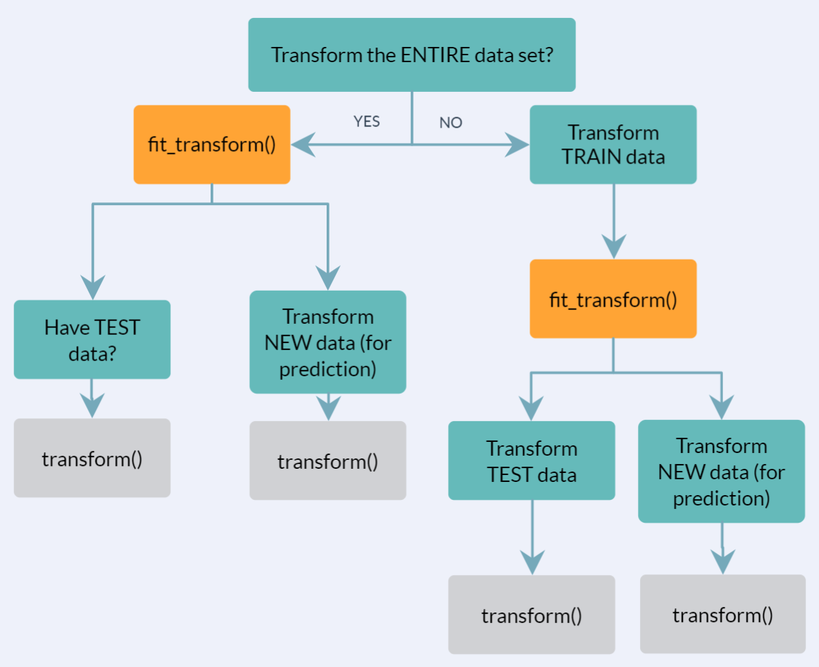
Data Transformation (fit_transform)
When to use fit_transform and transform()

Slide 16
Train Models
Select the right algorithm:
DecisionTreeRegressor OR DecisionTreeClassifier?
For classification: is it binary, multi-class?
Remember: can always convert multi-class to binary
Student can PASS, FAIL, EXTEND (multi-class
PASS or not (binary)
FAIL or not (binary)
EXTEND or not (binary)
Build the model for all three, send a new obs. to all three, select the outcome with highest probability! (SVM is a strictly binary classifier, but it can do this on its own)

Slide 17
Train Models
Select (appropriate) hyperparameters
Oversample if needed:
Example: 99% non-donors in a data set 100,000. Predict who will donate.
Use cross-validation (for low sample size)
Build alternative models to compare

Slide 18
Model Evaluation (to be discussed later)
Regression evaluation metric:
Mean squared error (MSE)
Root mean squared error (RMSE)
Classification evaluation metric:
Accuracy
Sensitivity/specificity
F1 score
ROC curve

Slide 19
Post-Evaluation Steps

Slide 20
Fine tuning
Change hyperparameters
Grid search!
Define the set of parameters
Perform a (random) search!
(Exhaustive search not recommended!)

Slide 21
Present Solution
Is the "error" acceptable?
Can you interpret the model (black-box or white box)?
Can you identify "variable importance"?

Slide 22
Launch, Monitor, Maintain
Is the model successful/effective?
How do you assess model effectiveness:
Compare model effectiveness
“Control” group Randomly chosen customers. Send coupon. | “Target” group Customers chosen by ML. Send coupon.
“Holdout” group Randomly chosen customers. Do not send coupon. | “Modeled holdout” group Customers chosen by ML. Do not send coupon.
Compare coupon effectiveness

Slide 23
Conclusion
Most time consuming & error prone
Problem definition
Get the data
Discover and visualize the data
Data preparation
Select a model and train
Fine tuning
Present solution
Launch, monitor, maintain
Evaluate the model
We will perform these steps in Python

Slide 24

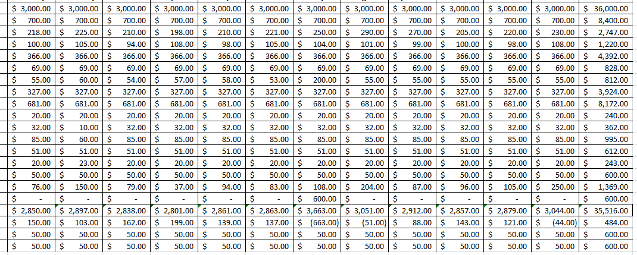


Python – Scikit – Data Prep - PIPELINES
Target column
Import into
Jupyter notebook
Column Transformer
Categorical
columns
Numerical
columns
Impute missing,
One-hot-encoding,
Etc.
Impute missing,
Standardize,
Etc.
Transformed data

Slide 25
Python – Scikit – Training & Evaluating
Train: fit_transform()
Train target
Build a model
Evaluate the model
Train inputs
Test inputs
Obtain train metrics
Obtain test metrics
Check overfitting
Check underfitting
Test: transform()
Test target
Fine tuning/
Grid search
Evaluate the model

